Slide 1
A simulation study on the properties of KCV-SMOTE and KFS with application to credit card fraud prediction
STATS 771
Pao Zhu Vivian Hsu
McMaster University
Department of Mathematics & Statistics
April 24th, 2024

Slide 2
Agenda
Introduction
KCV-SMOTE & KFS Method
Methods
Results
Discussion
Conclusion

Slide 3
Introduction

Slide 4
Motivation
Credit cards are an electronic form of payment that are popular for the convenience and protection they offer on everyday purchases
Detecting credit card fraud is crucial for credit card companies to maintain customer satisfaction and minimize losses
Machine learning techniques have become the predominant method to predict credit card fraud over the years
Companies are constantly looking for ways to improve their predictions

Slide 5
Literature Review
Some techniques mentioned in recent literature include:
Random forest, neural networks, SVM, k-nearest neighbours, logistic regression, Naïve Bayes
Common challenge that many researchers face when studying credit card fraud:
Imbalance of fraudulent and genuine transactions
Kang and Zhang introduced the K-fold cross-validation and synthetic minority over-sampling technique (KCV-SMOTE) and key feature scanning (KFS) method to address these challenges
The method was applied to a logistic regression approach and the final model had an AUC of 98.62%.

Slide 6
Research Gap
While this approach is promising to improve model performance for imbalanced data, there hasn’t been enough exploration on how it would perform under varying signal-to-noise ratios (SNRs)
Investigating this would provide insight into how robust and applicable this method is to a broader range of datasets
Goal of our study:
Investigate the KCV-SMOTE and KFS method’s performance under different proportions of unbalanced data and ratios of signal-to-noise
We will focus on signal predictors vs. noise predictors when we talk about SNRs

Slide 7
KCV-SMOTE & KFS METHOD

Slide 8
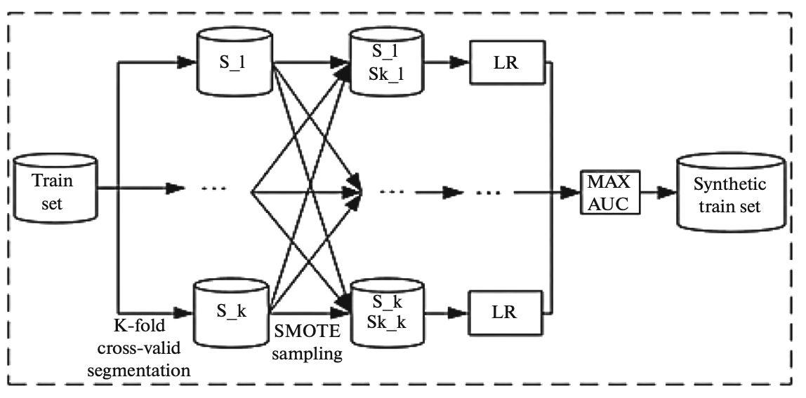
KCV-SMOTE
Takes a training set and produces a synthetic training set
Steps:
Divide the training set into k subsets
Perform SMOTE sampling (oversampling method) to obtain synthetic training sets for each subset
Train a logistic regression model for each of the subsets and obtain an AUROC score
Select the synthetic training set with the highest AUROC score

Slide 9
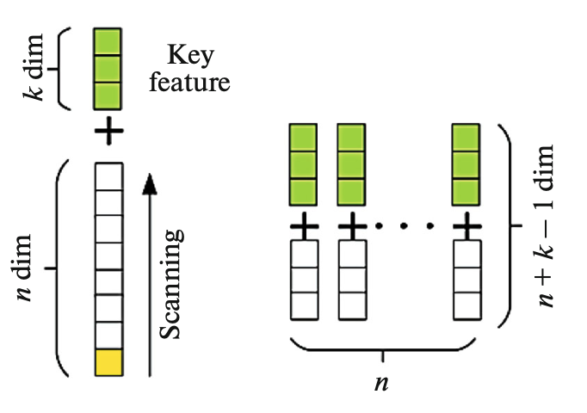
KFS
Creates multiple datasets with different combinations of predictor variables
Steps:
Divide the training set into key features and general features
Remove one feature from the general features and combine with key features to form a sub-training set
Do this multiple times by scanning through the general features to obtain multiple sub-training sets

Slide 10
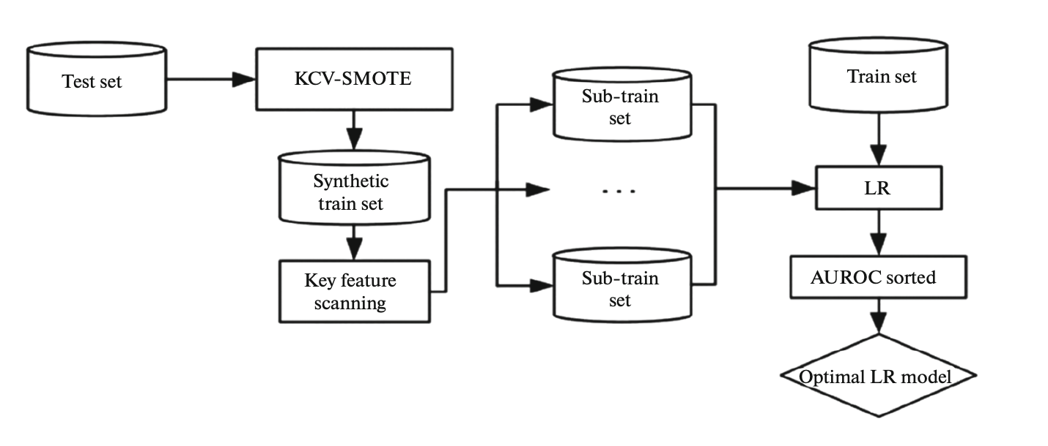
KCV-SMOTE & KFS Method
Steps:
Split data into a training set and a testing set.
Use KCV-SMOTE on the training set to obtain a synthetic training set.
Perform KFS on the synthetic training set to obtain sub-training sets.
Use each sub-training set to build a separate logistic regression model. Get the AUROC values for each model, sort them, and select the top sub-training sets with the highest scores.
Train the intersection of the sub-training sets from the previous step to obtain the best model, and input the test set into the best model to obtain the final prediction result.

Slide 11
Methods

Slide 12
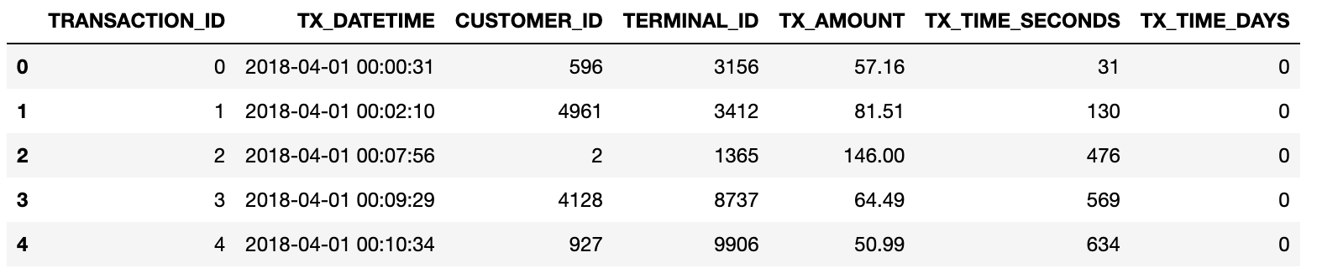
Data Simulation
Data is simulated using the transaction data simulator developed by the Machine Learning Group of ULB, the Université Libre de Bruxelles
First, we created the baseline transaction dataset:
Generated 5000 customer profiles and 10,000 terminal profiles
Generated about 3.5M genuine transactions using the profiles and common statistical distributions (ex. transaction amount is normally distributed with mean and standard deviation taken from the spending habits of customers in customer profiles)

Slide 13
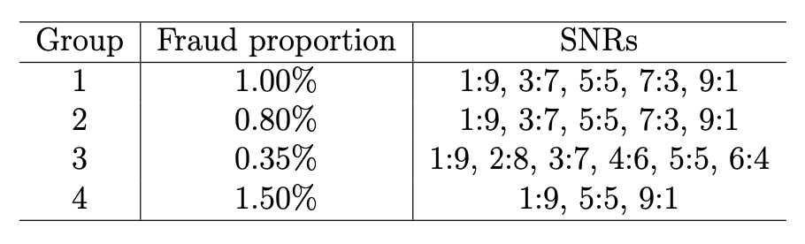
Data Simulation
Added fraud transactions to the baseline dataset to form 5 new datasets with a fraud proportions of 0.35%, 0.5%, 0.8%, 1%, and 1.5%
Created 19 more datasets with varying SNRs of predictor variables
Assumed all simulated predictors thus far are signal predictors
Added noise predictors by simulating variables containing arbitrary integer values from 1 to 100.

Slide 14

KCV-SMOTE & KFS Method
Applied KCV-SMOTE & KFS method to all 24 simulated datasets
Unbalanced classes analysis
5 model comparison
Confirm that the method performs well for unbalanced data as claimed by researchers
SNR analysis
19 model comparison
Fix the fraud proportion and compare model performance for different SNRs

Slide 15
Results

Slide 16
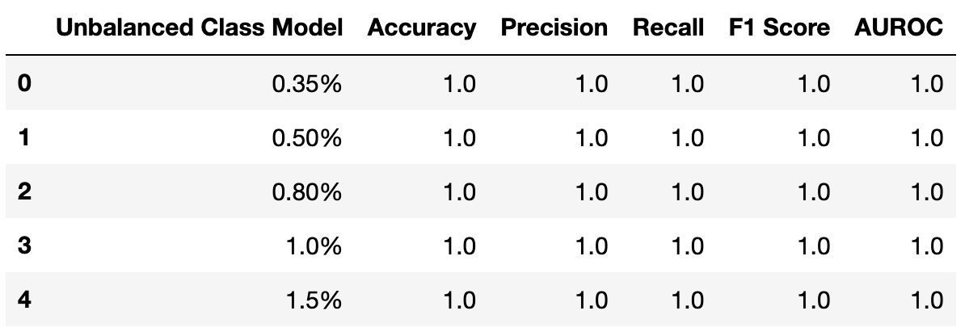
Unbalanced Classes Analysis
Performs very well for each of the simulated datasets indicating that it can handle data with high degrees of unbalanced classes

Slide 17
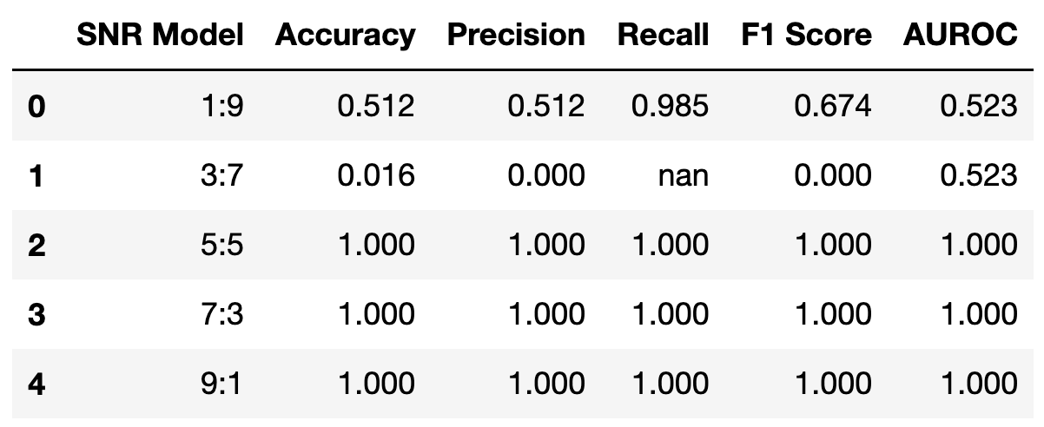
SNR Analysis – 1% Fraud Proportion
KCV-SMOTE and KFS method has unstable and poor performance when there are more noise predictors compared to signal predictors
Performs well when there is at least an even ratio of signal predictors to noise predictors.

Slide 18
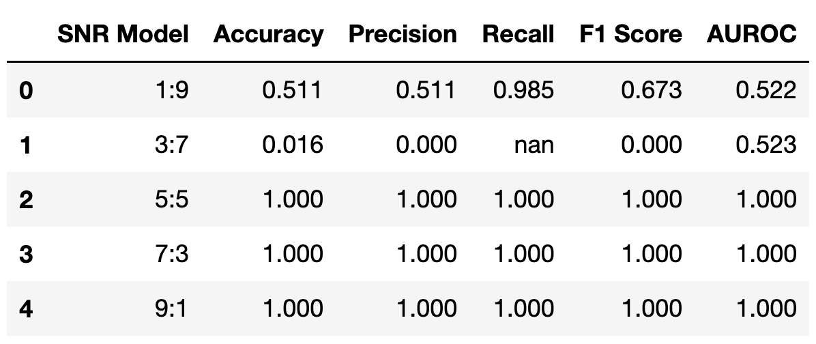
SNR Analysis – 0.8% Fraud Proportion
Similar results when the percentage of fraud in the dataset is changed to 0.8%

Slide 19
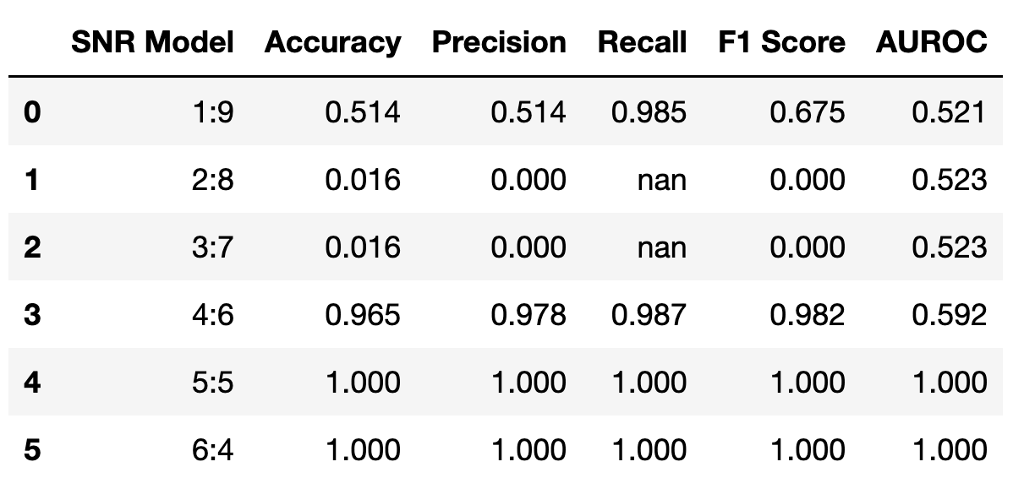
SNR Analysis – 0.35% Fraud Proportion
Investigated more cases where there is a higher number of noise predictors than signal predictors
Method also performs moderately well when there are 4 signal predictors and 6 noise predictors. Thus, there could be more noise predictors than signals.

Slide 20
SNR Analysis – Overall Results
Similar results were obtained for 1.5% fraud proportion as well
Having an SNR of at least 4:6 signal-to-noise predictors will yield promising results using KCV-SMOTE and KFS
Changes in fraud proportion do not have a major impact on model performance outcomes even with varying degrees of SNRs

Slide 21
Discussion

Slide 22
Improvements to our study
Experiment on different values of k parts when implementing KCV
Use a more rigorous approach to select key features when performing KFS
Having expertise from the credit card industry combined with the use of a classifier such as logistic regression can better inform our choice of key features
Study more combinations of class imbalance and SNRs
Ex. If we have data with 30 variables, we could investigate how the KCV-SMOTE and KFS method performs under more specific SNRs
Provide us a greater understanding of what the SNR threshold would be for the KCV-SMOTE and KFS method to produce effective prediction results

Slide 23
Improvements to our study
Perform a similar study using real data instead
We can treat the class imbalance proportion as fixed, assume all variables in the dataset are signal predictors and add simulated noise predictors into the study.
Since there is a greater risk involved when assuming real data as signal predictors, one can optionally perform a preliminary analysis to decide which predictors are most likely signals as opposed to noise

Slide 24
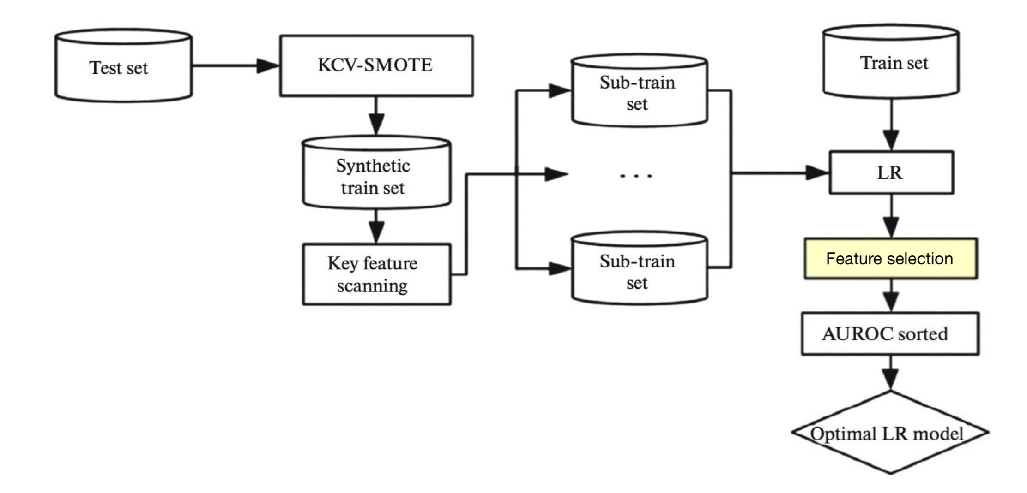
Proposed Modifications to KCV-SMOTE & KFS Method
One way we could modify the KCV-SMOTE & KFS method to reduce the effects of low SNRs is to add feature selection to the process
Backward stepwise elimination can be done after logistic regression is performed on each of the sub-training sets produced by KFS
This can help filter out predictors that have a high chance of being noise in each model

Slide 25
Proposed Modifications to KCV-SMOTE & KFS Method
There is a general debate on whether stepwise elimination should be applied on linear regression model fitting
To reduce the risk of potentially excluding important explanatory variables, we can use large significance levels during stepwise elimination
This is something that can be tuned by the researcher based on how comfortable they are with this risk in terms of their data
Further work is required to test this proposed modification and its ability to improve model performance for datasets with low SNRs.

Slide 26
Conclusion

Slide 27
Conclusion
Overall, our simulation study has provided greater insight into the effectiveness of Kang and Zhang’s method under different proportions of unbalanced data and ratios of signal-to-noise.
The method performed well on all tested percentages of highly imbalanced data, as claimed by Kang and Zhang
Having at least a 4:6 SNR of predictors will yield accurate results using KCV-SMOTE and KFS
SNRs lower than that will have poor and unstable performance
Proposed a modification to the method that uses stepwise elimination to reduce the effects of low SNRs
Further research is required to test this approach

Slide 28
Thank You!

Slide 29
References
[1] Fayaz Itoo, Meenakshi, and Satwinder Singh. Comparison and analysis of logistic regression, na ̈ıve bayes and knn machine learning algorithms for credit card fraud detection. International Journal of Information Technology, 13:1503–1511, 2021.
[2] Haiyan Kang and Hao Zhang. A new improved method for online credit anti-fraud. Automatic Control and Computer Sciences, 56:347–355, 2022.
[3] Yann-A ̈el Le Borgne, Wissam Siblini, Bertrand Lebichot, and Gianluca Bontempi. Reproducible Machine Learning for Credit Card Fraud Detection - Practical Handbook. Universit ́e Libre de Bruxelles, 2022.
[4] Rejwan Bin Sulaiman, Vitaly Schetinin, and Paul Sant. Review of machine learning approach on credit card fraud detection. Human Centric Intelligent Systems, 2:55–68, 2022.
[5] Worldline and Machine Learning Group - ULB. Credit card fraud detection, 2017.

